Slide 1
CSE 332 Data Abstractions: Disjoint Set Union-Find and Minimum Spanning Trees
Kate Deibel
Summer 2012

Slide 2
Making Connections
You have a set of nodes (numbered 1-9) on a network. You are given a sequence of pairwise connections between them:
3-5 4-2 1-6 5-7 4-8 3-7
Q: Are nodes 2 and 4 connected? Indirectly?
Q: How about nodes 3 and 8?
Q: Are any of the paired connections redundant due to indirect connections?
Q: How many sub-networks do you have?

Slide 3
Making Connections
Answering these questions is much easier if we create disjoint sets of nodes that are connected:
Start:
3-5
4-2
1-6
5-7
4-8
3-7
{1} {2} {3} {4} {5} {6} {7} {8} {9}
{1} {2} {3, 5} {4} {6} {7} {8} {9}
{1} {2, 4} {3, 5} {6} {7} {8} {9}
{1, 6} {2, 4} {3, 5} {7} {8} {9}
{1, 6} {2, 4} {3, 5, 7} {8} {9}
{1, 6} {2, 4, 8} {3, 5, 7} {9}
no change

Slide 4
Making Connections
Let's ask the questions again.
3-5 4-2 1-6 5-7 4-8 3-7
⇓
{1, 6} {2, 4, 8} {3, 5, 7} {9}
Q: Are nodes 2 and 4 connected? Indirectly?
Q: How about nodes 3 and 8?
Q: Are any of the paired connections redundant due to indirect connections?
Q: How many sub-networks do you have?

Slide 5
Disjoint Set Union-Find ADT
Separate elements into disjoint sets
If set x ≠ y then x ⋂ y = ∅ (i.e. no shared elements)
Each set has a name (usually an element in the set)
union(x,y): take the union of the sets x and y (x ⋃ y)
Given sets: {3,5,7} , {4,2,8}, {9}, {1,6}
union(5,1) → {3,5,7,1,6}, {4,2,8}, {9},
find(x): return the name of the set containing x.
Given sets: {3,5,7,1,6}, {4,2,8}, {9},
find(1) returns 5
find(4) returns 8

Slide 6
Disjoint Set Union-Find Performance
Believe it or not:
We can do Union in constant time.
We can get Find to be amortized constant time with worst case O(log n) for an individual Find operation
Let's see how…

Slide 7
First, Let's Get Lost
Beware of Minotaurs

Slide 8
What Makes a Good Maze?
We can get from any room to any other room (connected)
There is just one simple path between any two rooms (no loops)
The maze is not a simple pattern (random)

Slide 9
Making a Maze
A high-level algorithm for a random maze is easy:
Start with a grid
Pick Start and Finish
Randomly erase edges
START
FINISH

Slide 10
The Middle of the Algorithm
So far, we've knocked down several walls while others still remain.
Consider the walls between A and B and C and D
Which walls can we knock down and maintain both our connectedness and our no cycles properties?
How do we do this efficiently?
A
B
C
D
Notes:
Let’s say we’re in the middle of knocking out walls to make a good maze.
How do we decide whether to knock down the current wall?

Slide 11
Maze Algorithm: Number the Cells
Number each cell and treat as disjoint sets:
S ={ {1}, {2}, {3}, {4},… {36} }
Create a set of all edges between cells:
W ={ (1,2), (1,7), (2,8), (2,3), … } 60 walls total.
START
1
2
3
4
5
6
7
8
9
10
11
12
13
14
15
16
17
18
19
20
21
22
23
24
25
26
27
28
29
30
31
32
33
34
35
36
FINISH

Slide 12
Maze Algorithm: Building with DSUF
Algorithm sketch:
Choose a wall at random.
Erase wall if the neighbors are in disjoint sets (this avoids creating cycles)
Take union of those cell's sets
Repeat until there is only one set
Every cell is thus reachable from every other cell

Slide 13
The Secret To Why This Works
Notice that a connected, acyclic maze is actually a Hidden Tree
This suggests how we should implement the Disjoint Set Union-Find ADT
START
FINISH

Slide 14
Implementing DSUF with UP Trees
I promise the first twenty minutes of this section will not be the saddest trees you have ever seen…

Slide 15
Up Trees for Disjoin Set Union-Find
Up trees
Notes point to parent, not children
Thus only one pointer per node
In a DSUF
Each disjoint set is its own up tree
The root of the tree is the name for the disjoint set
Initial State
1
2
3
4
5
6
7
After Unions
1
3
7
4
5
2
6

Slide 16
Find Operation
find(x): follow x to the root and return the root (the name of the disjoint set)
find(1) = 1
find(3) = 3
find(4) = 1
find(6) = 7
1
3
7
4
5
2
6

Slide 17
Find Operation
union(i,j): assuming i and j are roots, point root i to root j
What if i or j is not a root?
Run a find on i and j first and use the returned values for the joining
Why do we join roots and not just the nodes?
union(1,7)
1
3
7
1
3
4
5
2
4
7
6
5
2
6

Slide 18
Simple Implementation
Once again, it is better to implement a tree using an array than with node objects
Leave up[0] empty (or # of disjoint sets)
up[x] = i means node x's parent is node i
up[x] = 0 means x is a root
1
3
7
1
2
3
4
5
6
7
4
5
2
up
0
7
0
1
7
2
0
6

Slide 19
Performance
Using array-based up trees, what is the cost for
union(i,j)?
find(x)?
union(i,j) is O(1) if i and j are roots
Otherwise depends on cost of find
find(x) is O(n) in worst-case
What does the worst-case look like?
7
5
3
6
2
1
4

Slide 20
Performance – Doing Better
The problem is that up trees get too tall
In order to make DSUF perform as we promised, we need to improve both our union and find algorithms:
Weighted Union
Path Compression
Only with BOTH of these will we get find to average-case O(log n) and amortized O(1)

Slide 21
Weighted Union
Instead of arbitrarily joining two roots, always point the smaller tree to the root of the larger tree
Each up tree has a weight (number of nodes)
The idea is to limit the height of each up tree
Trees with more nodes tend to be deeper
Union by rank or height are similar ideas but more complicated to implement
union(1,7)
2
1
4
1
6
1
3
7
3
7
4
5
2
1
5
2
6
4
6

Slide 22
Weighted Union Implementation
We can just use an additional array to store weights of the roots…
2
1
4
1
3
7
4
5
2
6
1
2
3
4
5
6
7
up
0
7
0
1
7
2
0
weight
2
1
4

Slide 23
Weighted Union Implementation
… or we use negative numbers to represent roots and their weights
But generally, saving O(n) space is not critical
2
1
4
1
3
7
4
5
2
6
1
2
3
4
5
6
7
up
-2
7
-1
1
7
2
-4

Slide 24
Weighted Union Performance
Weighted union gives us guaranteed worst-case O(log n) for find
The union rule prevents linear up trees
Convince yourself that it will produce at worst a fairly balanced binary tree
However, we promised ourselves O(1) amortized time for find
Weighted union does not give us enough
Average-case is still O(log n)

Slide 25
Motivating Path Compression
Recall splay trees
To speed up later finds, we moved searched for nodes to the root
Also improved performance for finding other nodes
Can we do something similar here?
Yes, but we cannot move the node to the root
Roots are the names of the disjoint set
Plus, we want to move associated nodes up at the same time
Why not move all nodes touched in a find to point directly to the root?

Slide 26
Path Compression
On a find operation point all the nodes on the search path directly to the root
Keep a stack/queue as you traverse up
Then empty to the stack/queue to repoint each stored node to the root
find(3)
7
7
9
5
2
9
5
2
6
3
8
6
8
4
1
3
4
1

Slide 27
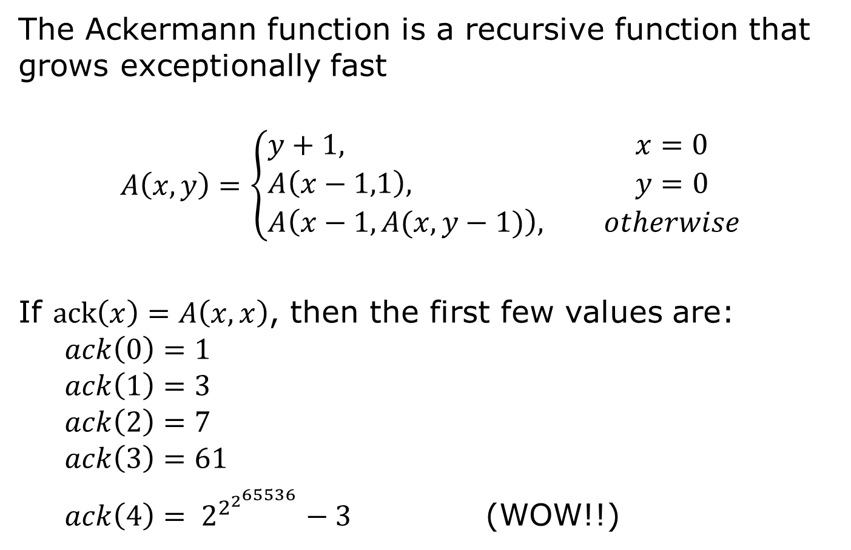
Digression: Ackermann Function
The Ackermann function is a recursive function that grows exceptionally fast
$$A\left(x,y\right)=\left\{\begin{aligned}&y+1, &x=0 \\ &A\left(x−1,1\right), &y=0 \\ &A\left(x−1,A(x,y−1)\right), &otherwise\end{aligned}\right.$$
If $ack\left(x\right)=A\left(x,x\right)$, then the first few values are:
$$ack\left(0\right)=1 \\ ack\left(1\right)=3 \\ ack\left(2\right)=7 \\ ack\left(3\right)=61$$ $ack\left(4\right)= 2^{2^{2^{65536}}}−3$ (WOW!!)

Slide 28
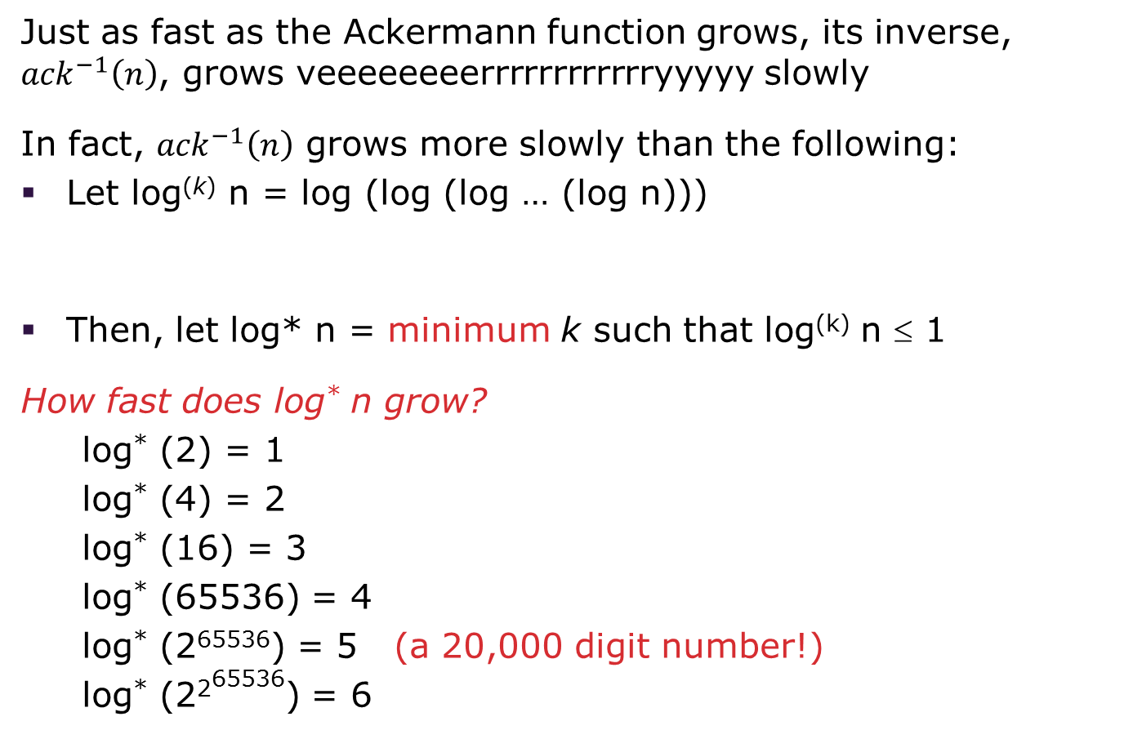
Digression: Inverse Ackermann
Just as fast as the Ackermann function grows, its inverse, ${ack}^{−1}\left(n\right)$, grows veeeeeeeerrrrrrrrrrrryyyyy slowly
In fact, ${ack}^{−1}\left(n\right)$ grows more slowly than the following:
Let log^{(k)} n = log (log (log … (log n)))
Then, let log* n = minimum k such that log^{(k)} n ≤ 1
How fast does log* n grow?
log* (2) = 1
log* (4) = 2
log* (16) = 3
log* (65536) = 4
log* (2⁶⁵⁵³⁶) = 5 (a 20,000 digit number!)
log* (2²⁶⁵⁵³⁶) = 6
k logs
Notes:
Let’s talk about some funky doped horses at the silicon downs.

Slide 29
Optimized Disjoint Set Union-Find
Tarjan (1984) proved that m weighted union and find with path compression operations on a set of n elements have worst case complexity O(m·ack⁻¹(n))
For all practical purposes this is amortized constant time as ack⁻¹(n) < 5 for reasonable n
More generally, the total cost of m finds (with at most n-1 unions—why?), the total work is: O(m+n)
Again, this is O(1) amortized with O(1) worst-case for union and O(log n) worst-case for find
One can also show that any implementation of find and union cannot both be worst-case O(1)
Notes:
OK, now, your book shows a proof that find now takes amortized O(log*n)
but actually, it’s even better than that: O(alpha(m,n)) time.
Basically amortized 1.
Can anyone think why the alpha doesn’t matter even in any good theoretical sense?
Remember B-Trees: they showed us that our model was bogus for large data sets. By the time alpha gets near 4, our data sets are already larger than we can even imagine.

Slide 30
Minimum Spanning Trees
With no surprise, DSUF will be very useful here

Slide 31
General Problem: Spanning a Graph
A simple problem: Given a connected graph G=(V,E), find a minimal subset of the edges such that the graph is still connected
A graph G₂=(V,E2) such that G₂ is connected and removing any edge from E₂ makes G₂ disconnected

Slide 32
Observations
Any solution to this problem is a tree
Recall a tree does not need a root; just means acyclic
For any cycle, could remove an edge and still be connected
We usually just call the solutions spanning trees
Solution not unique unless original graph was already a tree
Problem ill-defined if original graph not connected
We can find a spanning tree per connected component of the graph
This is often called a spanning forest
A tree with |V| nodes has |V|-1 edges
This every spanning tree solution has |V|-1 edges

Slide 33
We Saw This Earlier
Our acyclic maze consisted of a tree that touched ever square of the grid
START
FINISH

Slide 34
Motivation
A spanning tree connects all the nodes with as few edges as possible
Example: A “phone tree” so everybody gets the message and no unnecessary calls get made
Bad example since would prefer a balanced tree
In most compelling uses, we have a weighted undirected graph and want a tree of least total cost
Minimize electrical wiring for a house or wires on a chip
Minimize road network if you cared about asphalt cost
This is the minimum spanning tree problem
Will do that next, after intuition from the simpler case

Slide 35
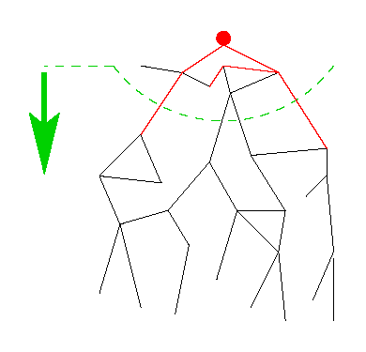
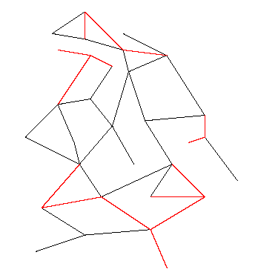
Finding Unweighted Spanning Trees
Different algorithmic approaches to the spanning-tree problem:
Do a graph traversal (e.g., depth-first search, but any traversal will do) and keep track of edges that form a tree
or, iterate through edges and add to output any edge that doesn’t create a cycle

Slide 36
Spanning Tree via DFS
spanning_tree(Graph G) {
for each node i: i.marked = false
for some node i: f(i)
}
f(Node i) {
i.marked = true
for each j adjacent to i:
if(!j.marked) {
add(i,j) to output
f(j) // DFS
}
}
Correctness: DFS reaches each node. We add one edge to connect it to the already visited nodes. Order affects result, not correctness.
Time: O(|E|)

Slide 37
DFS Spanning Tree Example
Stack
f(1)
2
1
3
7
4
6
5
Output:

Slide 38
DFS Spanning Tree Example
Stack
f(1)
f(2)
2
1
3
7
4
6
5
Output: (1,2)

Slide 39
DFS Spanning Tree Example
Stack
f(1)
f(2)
f(7)
2
1
3
7
4
6
5
Output: (1,2), (2,7)

Slide 40
DFS Spanning Tree Example
Stack
f(1)
f(2)
f(7)
f(5)
2
1
3
7
4
6
5
Output: (1,2), (2,7), (7,5)

Slide 41
DFS Spanning Tree Example
Stack
f(1)
f(2)
f(7)
f(5)
f(4)
2
1
3
7
4
6
5
Output: (1,2), (2,7), (7,5), (5,4)

Slide 42
DFS Spanning Tree Example
Stack
f(1)
f(2)
f(7)
f(5)
f(4)
f(3)
2
1
3
7
4
6
5
Output: (1,2), (2,7), (7,5), (5,4), (4,3)

Slide 43
DFS Spanning Tree Example
Stack
f(1)
f(2)
f(7)
f(5)
f(4)
f(3)
f(6)
2
1
3
7
4
6
5
Output: (1,2), (2,7), (7,5), (5,4), (4,3), (5,6)

Slide 44
DFS Spanning Tree Example
Stack
f(1)
f(2)
f(7)
f(5)
f(4) f(6)
f(3)
2
1
3
7
4
6
5
Output: (1,2), (2,7), (7,5), (5,4), (4,3), (5,6)

Slide 45
Second Approach
Iterate through edges; output any edge that does not create a cycle
Correctness (hand-wavy):
Goal is to build an acyclic connected graph
When we add an edge, it adds a vertex to the tree (or else it would have created a cycle)
The graph is connected, we consider all edges
Efficiency:
Depends on how quickly you can detect cycles
Reconsider after the example

Slide 46
Example
Edges in some arbitrary order:
(1,2), (3,4), (5,6), (5,7),(1,5), (1,6), (2,7), (2,3), (4,5), (4,7)
2
1
3
7
4
6
5
Output:

Slide 47
Example
Edges in some arbitrary order:
(1,2), (3,4), (5,6), (5,7),(1,5), (1,6), (2,7), (2,3), (4,5), (4,7)
2
1
3
7
4
6
5
Output: (1,2)

Slide 48
Example
Edges in some arbitrary order:
(1,2), (3,4), (5,6), (5,7),(1,5), (1,6), (2,7), (2,3), (4,5), (4,7)
2
1
3
7
4
6
5
Output: (1,2), (3,4)

Slide 49
Example
Edges in some arbitrary order:
(1,2), (3,4), (5,6), (5,7),(1,5), (1,6), (2,7), (2,3), (4,5), (4,7)
2
1
3
7
4
6
5
Output: (1,2), (3,4), (5,6)

Slide 50
Example
Edges in some arbitrary order:
(1,2), (3,4), (5,6), (5,7), (1,5), (1,6), (2,7), (2,3), (4,5), (4,7)
2
1
3
7
4
6
5
Output: (1,2), (3,4), (5,6), (5,7)

Slide 51
Example
Edges in some arbitrary order:
(1,2), (3,4), (5,6), (5,7), (1,5), (1,6), (2,7), (2,3), (4,5), (4,7)
2
1
3
7
4
6
5
Output: (1,2), (3,4), (5,6), (5,7), (1,5)

Slide 52
Example
Edges in some arbitrary order:
(1,2), (3,4), (5,6), (5,7), (1,5), (1,6), (2,7), (2,3), (4,5), (4,7)
2
1
3
7
4
6
5
Output: (1,2), (3,4), (5,6), (5,7), (1,5)

Slide 53
Example
Edges in some arbitrary order:
(1,2), (3,4), (5,6), (5,7), (1,5), (1,6), (2,7), (2,3), (4,5), (4,7)
2
1
3
7
4
6
5
Output: (1,2), (3,4), (5,6), (5,7), (1,5)

Slide 54
Example
Edges in some arbitrary order:
(1,2), (3,4), (5,6), (5,7), (1,5), (1,6), (2,7), (2,3), (4,5), (4,7)
2
1
3
Can stop once we have |V|-1 edges
7
4
6
5
Output: (1,2), (3,4), (5,6), (5,7), (1,5), (2,3)

Slide 55
Cycle Detection
To decide if an edge could form a cycle is O(|V|) because we may need to traverse all edges already in the output
So overall algorithm would be O(|V||E|)
But it is faster way to use the DSUF ADT
Initially, each vertex is in its own 1-element set
find(u): what set contains u?
union(u,v): combine the sets containing u and v

Slide 56
Using Disjoint-Set to Detect Cycles
Invariant: u and v are connected in output-so-far if and only if u and v in the same set
Algorithm:
Initially, each node is in its own set
When processing edge (u,v):
If find(u)==find(v), then do not add the edge
Else add the edge and union(u,v)

Slide 57
Summary so Far
The spanning-tree problem
Add nodes to partial tree approach is O(|E|)
Add acyclic edges approach is O(|E| log |V|)
But what we really want to solve is the minimum-spanning-tree problem
Given a weighted undirected graph, find a spanning tree of minimum weight
The above approaches suffice with minor changes
Both will be O(|E| log |V|)

Slide 58
Prim and KruskaL's Algorithms
Like vi versus emacs except people do not typically fight over which one is better (emacs and Kruskal are best!)

Slide 59
One Problem, Two Algorithms
Algorithm #1: Prim's Algorithm
Shortest-path is to Dijkstra’s Algorithm as Minimum Spanning Tree is to Prim’s Algorithm
Both based on expanding cloud of known vertices, basically using a priority queue
Algorithm #2: Kruskal's Algorithm
Exactly our forest-merging approach to spanning tree but process edges in cost order

Slide 60
Idea: Prim’s Algorithm
Central Idea:
Grow a tree by adding an edge from the “known” vertices to the “unknown” vertices.
Pick the edge with the smallest weight that connects “known” to “unknown.”
Recall Dijkstra picked “edge with closest known distance to source.”
But that is not what we want here
Otherwise identical
Feel free to look back and compare

Slide 61
Pseudocode: Prim's Algorithm
For each node v, set v.cost = ∞ and v.known = false
Choose any node v.
Mark v as known
For each edge (v,u) with weight w, set u.cost = w and u.prev = v
While there are unknown nodes in the graph
Select the unknown node v with lowest cost
Mark v as known and add (v, v.prev) to output
For each edge (v,u) with weight w,
if(w < u.cost) {
u.cost = w;
u.prev = v;
}

Slide 62
Example: Prim's Algorithm
2
A
B
1
1
5
2
1
E
1
D
C
5
3
6
G
vertex | known? | cost | prev
A
B
C
D
E
F
G
10
2
F

Slide 63
Example: Prim's Algorithm
2
A
B
1
1
5
2
1
E
1
D
C
5
3
6
G
vertex | known? | cost | prev
A | Y | 0 | -
B |  | 2 | A
C |  | 2 | A
D |  | 1 | A
E
F
G
10
2
F

Slide 64
Example: Prim's Algorithm
2
A
B
1
1
5
2
1
E
1
D
C
5
3
6
G
vertex | known? | cost | prev
A | Y | 0 | -
B |  | 2 | A
C |  | 2 1 | A D
D | Y | 1 | A
E |  | 1 | D
F |  | 6 | D
G |  | 5 | D
10
2
F

Slide 65
Example: Prim's Algorithm
2
A
B
1
1
5
2
1
E
1
D
C
5
3
6
G
vertex | known? | cost | prev
A | Y | 0 | -
B |  | 2 | A
C | Y | 2 1 | A D
D | Y | 1 | A
E |  | 1 | D
F |  | 6 2 | D C
G |  | 5 | D
10
2
F

Slide 66
Example: Prim's Algorithm
2
A
B
1
1
5
2
1
E
1
D
C
5
3
6
G
vertex | known? | cost | prev
A | Y | 0 | -
B |  | 2 1 | A E
C | Y | 2 1 | A D
D | Y | 1 | A
E | Y | 1 | D
F |  | 6 2 | D C
G |  | 5 3 | D E
10
2
F

Slide 67
Example: Prim's Algorithm
2
A
B
1
1
5
2
1
E
1
D
C
5
3
6
G
vertex | known? | cost | prev
A | Y | 0 | -
B | Y | 2 1 | A E
C | Y | 2 1 | A D
D | Y | 1 | A
E | Y | 1 | D
F |  | 6 2 | D C
G |  | 5 3 | D E
10
2
F

Slide 68
Example: Prim's Algorithm
2
A
B
1
1
5
2
1
E
1
D
C
5
3
6
G
vertex | known? | cost | prev
A | Y | 0 | -
B | Y | 2 1 | A E
C | Y | 2 1 | A D
D | Y | 1 | A
E | Y | 1 | D
F | Y | 6 2 | D C
G |  | 5 3 | D E
10
2
F

Slide 69
Example: Prim's Algorithm
2
A
B
1
1
5
2
1
E
1
D
C
5
3
6
G
vertex | known? | cost | prev
A | Y | 0 | -
B | Y | 2 1 | A E
C | Y | 2 1 | A D
D | Y | 1 | A
E | Y | 1 | D
F | Y | 6 2 | D C
G | Y | 5 3 | D E
10
2
F

Slide 70
Example: Prim's Algorithm
Output:
(A, D) (C, F)
(B, E) (D, E)
(C, D) (E, G)
Total Cost: 9
2
A
B
1
1
5
2
1
E
1
D
C
5
3
6
G
vertex | known? | cost | prev
A | Y | 0 | -
B | Y | 2 1 | A E
C | Y | 2 1 | A D
D | Y | 1 | A
E | Y | 1 | D
F | Y | 6 2 | D C
G | Y | 5 3 | D E
10
2
F

Slide 71
Analysis: Prim's Algorithm
Correctness
Intuitively similar to Dijkstra's algorithm
Run-time
Same as Dijkstra's algorithm
O(|E| log |V|) using a priority queue

Slide 72
Idea: Kruskal’s Algorithm
Central Idea:
Grow a forest out of edges that do not grow a cycle, just like for the spanning tree problem.
But now consider the edges in order by weight
Basic implementation:
Sort edges by weight → O(|E| log |E|) = O(|E| log |V|)
Iterate through edges using DSUF for cycle detection → O(|E| log |V|)
Somewhat better implementation:
Floyd’s algorithm to build min-heap with edges → O(|E|)
Iterate through edges using DSUF for cycle detection and deleteMin to get next edge → O(|E| log |V|)
Not better worst-case asymptotically, but often stop long before considering all edges

Slide 73
Pseudocode: Kruskal's Algorithm
Put edges in min-heap using edge weights
Create DSUF with each vertex in its own set
While output size < |V|-1
Consider next smallest edge (u,v)
if find(u,v) indicates u and v are in different sets
output (u,v)
union(u,v)
Recall invariant:
u and v in same set if and only if connected in output-so-far

Slide 74
Example: Kruskal's Algorithm
Edges in sorted order:
1: (A,D) (C,D) (B,E) (D,E)
2: (A,B) (C,F) (A,C)
3: (E,G)
5: (D,G) (B,D)
6: (D,F)
10: (F,G)
2
A
B
1
1
5
2
1
E
1
D
C
5
3
6
G
10
2
F
Sets: (A) (B) (C) (D) (E) (F) (G)
Output:
At each step, the union/find sets are the trees in the forest

Slide 75
Example: Kruskal's Algorithm
Edges in sorted order:
1: (A,D) (C,D) (B,E) (D,E)
2: (A,B) (C,F) (A,C)
3: (E,G)
5: (D,G) (B,D)
6: (D,F)
10: (F,G)
2
A
B
1
1
5
2
1
E
1
D
C
5
3
6
G
10
2
F
Sets: (A,D) (B) (C) (E) (F) (G)
Output: (A,D)
At each step, the union/find sets are the trees in the forest

Slide 76
Example: Kruskal's Algorithm
Edges in sorted order:
1: (A,D) (C,D) (B,E) (D,E)
2: (A,B) (C,F) (A,C)
3: (E,G)
5: (D,G) (B,D)
6: (D,F)
10: (F,G)
2
A
B
1
1
5
2
1
E
1
D
C
5
3
6
G
10
2
F
Sets: (A,C,D) (B) (E) (F) (G)
Output: (A,D) (C,D)
At each step, the union/find sets are the trees in the forest

Slide 77
Example: Kruskal's Algorithm
Edges in sorted order:
1: (A,D) (C,D) (B,E) (D,E)
2: (A,B) (C,F) (A,C)
3: (E,G)
5: (D,G) (B,D)
6: (D,F)
10: (F,G)
2
A
B
1
1
5
2
1
E
1
D
C
5
3
6
G
10
2
F
Sets: (A,C,D) (B,E) (F) (G)
Output: (A,D) (C,D) (B,E)
At each step, the union/find sets are the trees in the forest

Slide 78
Example: Kruskal's Algorithm
Edges in sorted order:
1: (A,D) (C,D) (B,E) (D,E)
2: (A,B) (C,F) (A,C)
3: (E,G)
5: (D,G) (B,D)
6: (D,F)
10: (F,G)
2
A
B
1
1
5
2
1
E
1
D
C
5
3
6
G
10
2
F
Sets: (A,B,C,D,E) (F) (G)
Output: (A,D) (C,D) (B,E) (D,E)
At each step, the union/find sets are the trees in the forest

Slide 79
Example: Kruskal's Algorithm
Edges in sorted order:
1: (A,D) (C,D) (B,E) (D,E)
2: (A,B) (C,F) (A,C)
3: (E,G)
5: (D,G) (B,D)
6: (D,F)
10: (F,G)
A
B
1
1
5
2
1
E
1
D
C
5
3
6
G
10
2
F
Sets: (A,B,C,D,E) (F) (G)
Output: (A,D) (C,D) (B,E) (D,E)
At each step, the union/find sets are the trees in the forest

Slide 80
Example: Kruskal's Algorithm
Edges in sorted order:
1: (A,D) (C,D) (B,E) (D,E)
2: (A,B) (C,F) (A,C)
3: (E,G)
5: (D,G) (B,D)
6: (D,F)
10: (F,G)
A
B
1
1
5
2
1
E
1
D
C
5
3
6
G
10
2
F
Sets: (A,B,C,D,E,F) (G)
Output: (A,D) (C,D) (B,E) (D,E) (C,F)
At each step, the union/find sets are the trees in the forest

Slide 81
Example: Kruskal's Algorithm
Edges in sorted order:
1: (A,D) (C,D) (B,E) (D,E)
2: (A,B) (C,F) (A,C)
3: (E,G)
5: (D,G) (B,D)
6: (D,F)
10: (F,G)
A
B
1
1
5
1
E
1
D
C
5
3
6
G
10
2
F
Sets: (A,B,C,D,E,F) (G)
Output: (A,D) (C,D) (B,E) (D,E) (C,F)
At each step, the union/find sets are the trees in the forest

Slide 82
Example: Kruskal's Algorithm
Edges in sorted order:
1: (A,D) (C,D) (B,E) (D,E)
2: (A,B) (C,F) (A,C)
3: (E,G)
5: (D,G) (B,D)
6: (D,F)
10: (F,G)
A
B
1
1
5
1
E
1
D
C
5
3
6
G
10
2
F
Sets: (A,B,C,D,E,F,G)
Output: (A,D) (C,D) (B,E) (D,E) (C,F) (E,G)
At each step, the union/find sets are the trees in the forest

Slide 83
Analysis: Kruskal's Algorithm
Correctness: It is a spanning tree
When we add an edge, it adds a vertex to the tree (or else it would have created a cycle)
The graph is connected, we consider all edges
Correctness: That it is minimum weight
Can be shown by induction
At every step, the output is a subset of a minimum tree
Run-time
O(|E| log |V|)

Slide 84
So Which Is Better?
Time/space complexities essentially the same
Both are fairly simple to implement
Still, Kruskal's is slightly better
If the graph is not connected, Kruskal's will find a forest of minimum spanning trees

Slide 85
Wrapping Up Data Abstractions
*sniff*

Slide 86
That's All Folks
Disjoint Set Union-Find and minimum spanning trees are the last topics we will get to cover
Still, there are plenty more data structures, algorithms and applications out there to learn
You have the basics now

Slide 87
Your Programming Mind has Changed
Before, you often thought first about code
Declare a variable, a for-loop here, an if-else statement there, etc.
Now, you will see a problem and also think of the data structure
Lots of lookups… use a hashtable
Is this a graph and shortest path problem?
Etc.

Slide 88
Most Important Lesson
There is rarely a best programming solution
Every solution has strengths and weaknesses
The key is to be able to argue in favor of your approach over others
Just remember: Even though QuickSort's name says it is fast, it is not always the best sort every time

Slide 89
Cheers, Thanks, Whee!
Take care
Fill out the evaluations… I read these!!
Good luck on the final
Remember: Optional Section on Thursday
Get your final back
Free doughnuts!
And maybe another cool data structure

